Slide 1
8086 and Memory Interfacing Part 2
Md. Shafqat Talukder Rakin
Lecturer, Department of CSE,
United International University
Email id : shafqat@cse.uiu.ac.bd
Courtesy: Nasif M. Sir

Slide 2
Draw the diagram of 8-bit microprocessor with 16 bit address bus interfaced with 9KB RAM using linear decoding method. Each RAM chip has 12 bit address bus and 8 bit data bus. Also provide the corresponding address map for each RAM chip.

Slide 3
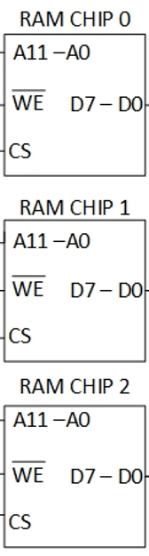

Slide 4
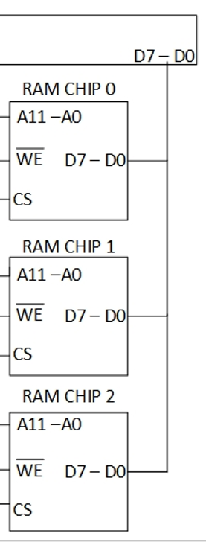

Slide 5
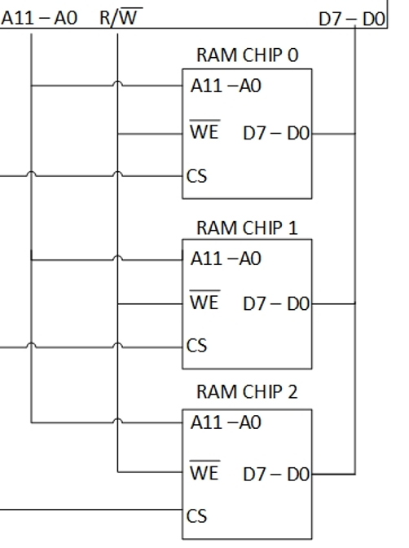

Slide 6
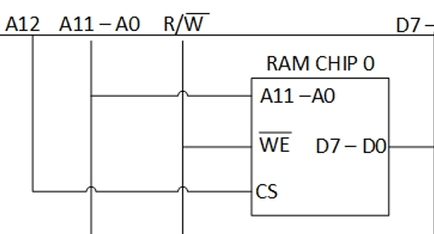

Slide 7
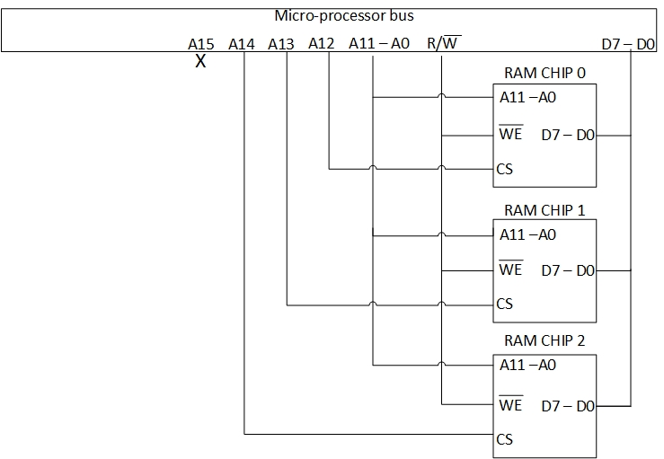

Slide 8
Address A15-A14-A13-A12-A11-A10-A9-A8-A7-A6-A5-A4-A3-A2-A1-A0 | RAM CHIP
0 0 0 1 0 0 0 0 0 0 0 0 0 0 0 0 | 1000 H 1FFF H
0 0 0 1 1 1 1 1 1 1 1 1 1 1 1 1
0 0 1 0 0 0 0 0 0 0 0 0 0 0 0 0 | 2000 H 2FFF H
0 0 1 0 1 1 1 1 1 1 1 1 1 1 1 1
0 1 0 0 0 0 0 0 0 0 0 0 0 0 0 0 | 4000 H 4FFF H
0 1 0 0 1 1 1 1 1 1 1 1 1 1 1 1

Slide 9
Draw the diagram of 8-bit microprocessor with 16 bit address bus interfaced with 7KB RAM using the full decoding technique. Each RAM chip has 10 bit address bus and 8 bit data bus. Also provide the corresponding address map for each RAM chip.

Slide 10


Slide 11
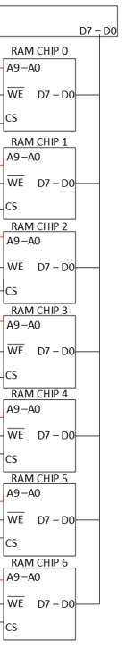

Slide 12
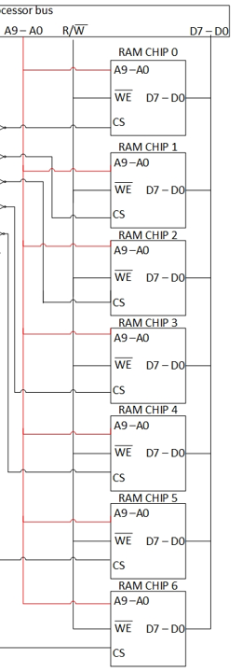

Slide 13
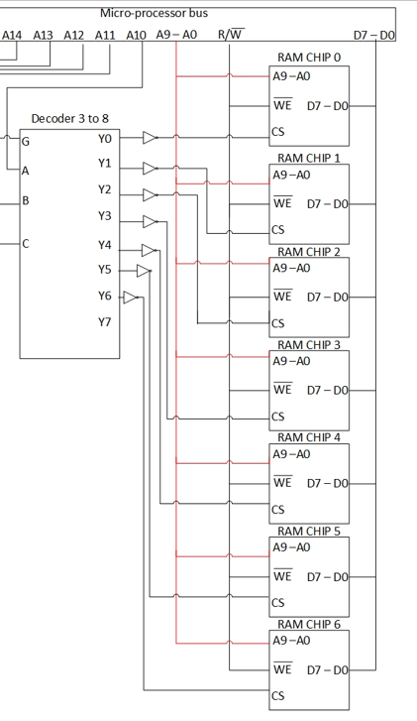

Slide 14
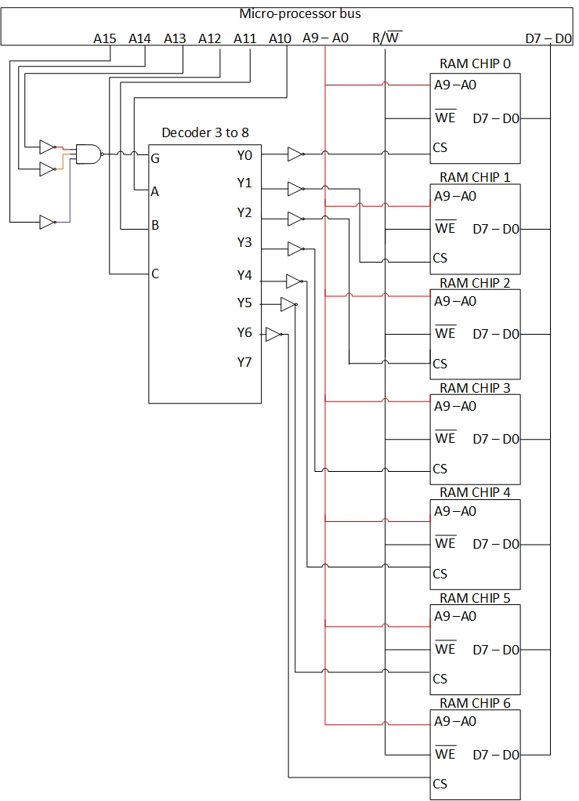

Slide 15
Address A15-A14-A13-A12-A11-A10-A9-A8-A7-A6-A5-A4-A3-A2-A1-A0 | RAM CHIP
0 0 0 0 0 0 0 0 0 0 0 0 0 0 0 0 | 0000 H 03FF H
0 0 0 0 0 0 1 1 1 1 1 1 1 1 1 1
0 0 0 0 0 1 0 0 0 0 0 0 0 0 0 0 | 0400 H 07FF H
0 0 0 0 0 1 1 1 1 1 1 1 1 1 1 1
0 0 0 0 1 0 0 0 0 0 0 0 0 0 0 0 | 0800 H 0BFF H
0 0 0 0 1 0 1 1 1 1 1 1 1 1 1 1
0 0 0 0 1 1 0 0 0 0 0 0 0 0 0 0 | 0C00 H 0FFF H
0 0 0 0 1 1 1 1 1 1 1 1 1 1 1 1
0 0 0 1 0 0 0 0 0 0 0 0 0 0 0 0 | 1000 H 13FF H
0 0 0 1 0 0 1 1 1 1 1 1 1 1 1 1

Slide 16
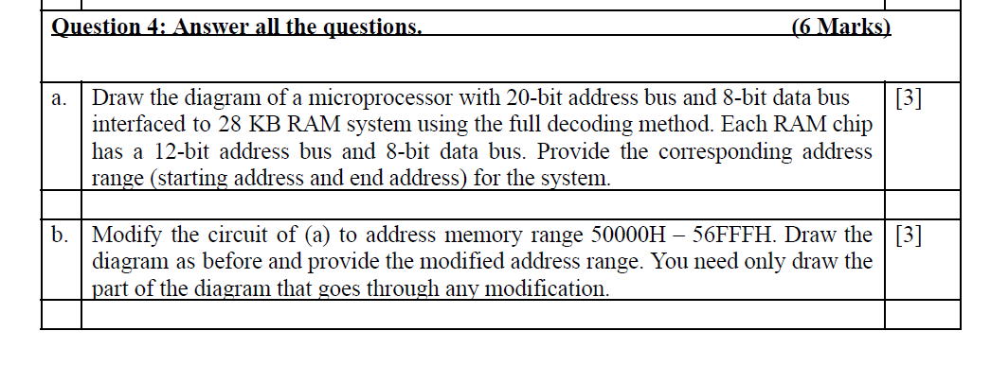

Slide 17
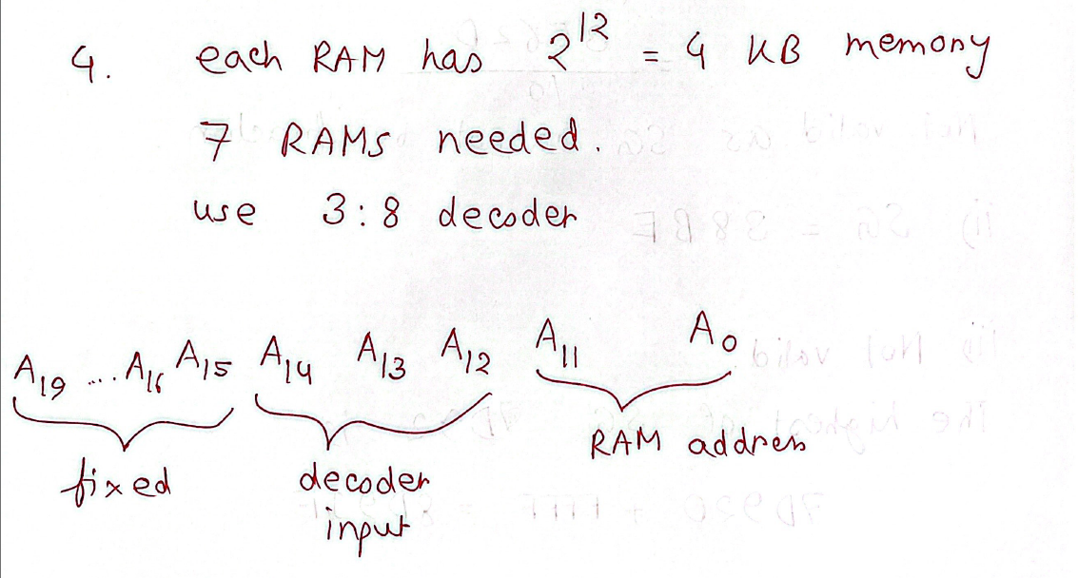

Slide 18
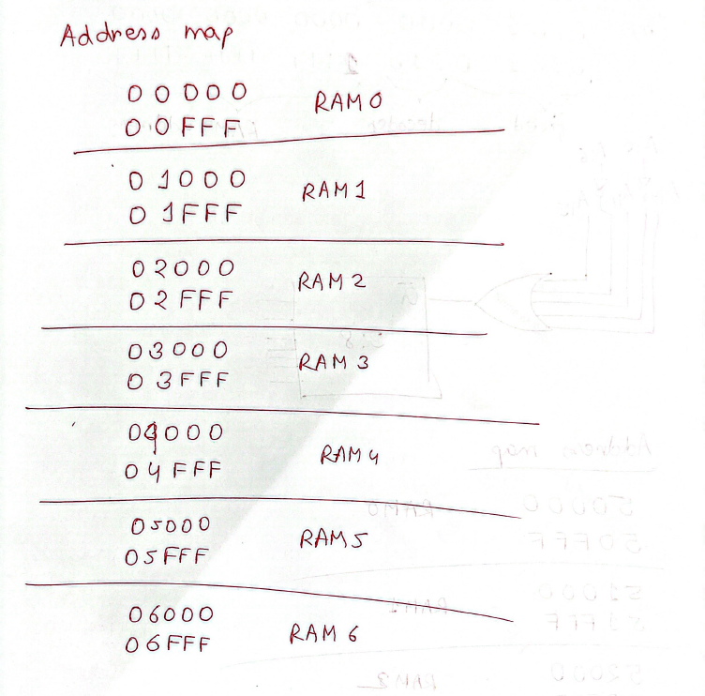

Slide 19
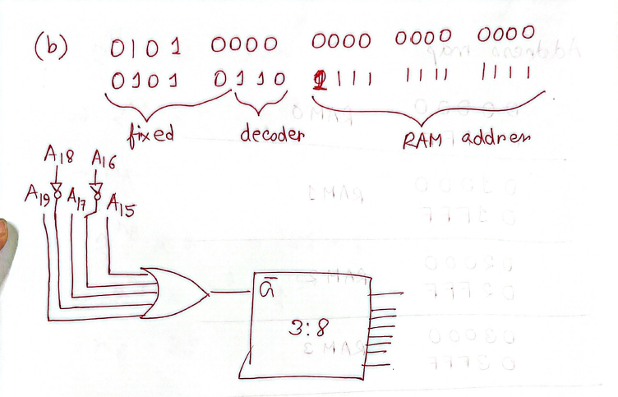

Slide 20
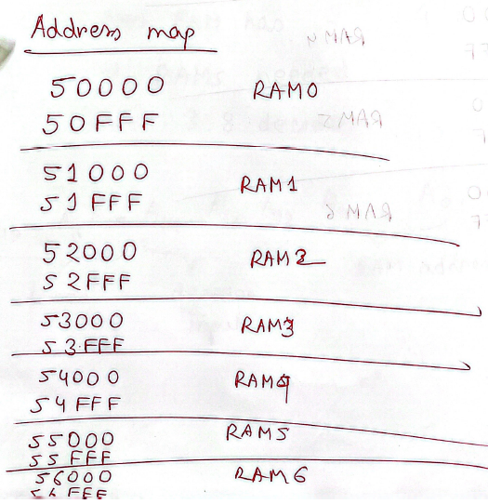

Slide 21
Thank you

